Slide 1
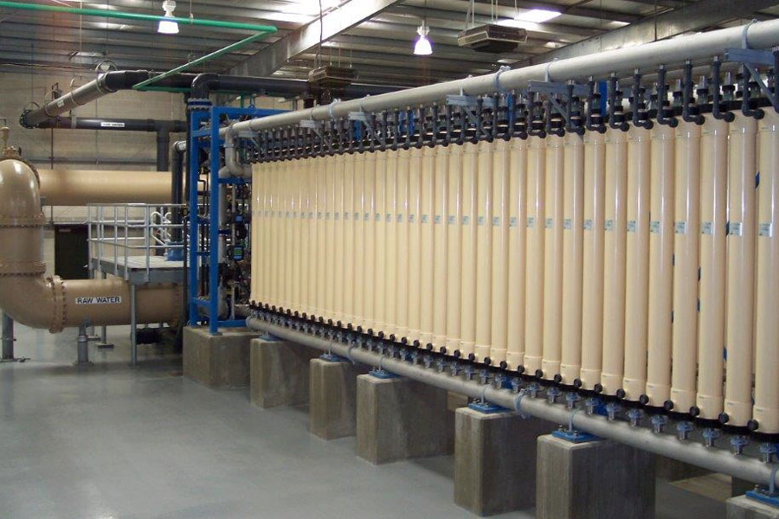
Membrane Filtration
Notes:
$14,800,000
https://www.kpaengineers.com/portfolio-items/membrane-filtration-plant/
15 MGD
No pretreatment
$22500 /(L/s)
Actuually operates at 11.6 MGD
Project Description: The City of Temple, Texas owns and operates the 11.6 MGD Membrane Water Treatment Plant. The plant was placed into operation in 2004 and operated as originally designed for the first 12 to 15 months. However, over the past several years the plant has not been able to consistently operate at the design capacity. $590,524 to upgrade the chemical cleaning
Realized they needed pretreatment in 2008
Backwash Sedimentation $2,607,785

Slide 2
Conventional Units in Env. Eng.
Surface loading rates
Flux
gpm/ft2
Lph/m2
A modest proposal.
Let’s consistently use the simplest SI units so that we can compare across processes and bring physical insight
The standard unit of time is seconds.

Slide 3
Membrane Filtration for Drinking Water Treatment
Removal by size exclusion
Size of contaminants
Head loss through a pore
Number of pores per area of membrane
Typical filtration approach velocities
How do they achieve reasonable flow rates per unit area?
Low pressure and high pressure systems
Fouling
DOM removal
Notes:
Brent Alspach
Membrane filtration is certainly carving out a substantive niche in drinking water treatment, but I wouldn’t say that they’re generally preferred; nor would I expect them to overtake the use of conventional treatment any time soon.
I’m not aware of any generalized comparison between media (rapid sand) filters and MF/UF, primarily due lots of variability with site-specific factors, the membrane product used, and system capacity, among others. The performance comparison should be pretty straightforward, but the relative costs and other issues (e.g., maintenance, automation, etc.) can be very different from site-to-site and client-to-client.
It might be better to simply stick to performance-based factors in teaching your class, and then noting the other items that are more subjective and can influence the selection of one technology over another. This would have more practical value for your students then some kind of a generalized comparison that is assumed (almost certainly erroneously) to be broadly applicable.
Membranes (and other advanced treatment technologies) are the same as more conventional processes, in which you’d do some calculations to size the system, based on theory described in texts. In practice, as an engineer, you really have to understand what the technology is capable of doing, along with its pros and cons, operational nuances, potential challenges, etc., and then if the technology is a good candidate for an application, you’d rely on the vendor to size the system. Alternatively, if possible within budget and scheduling constraints, you might also conduct a pilot test, which would give the engineer more direct information to specify design criteria. (Just to clarify – this is MF/UF; the paradigm is a bit different than NF/RO.)
There are some AWWA Manuals of Practice for both MF/UF and NF/RO, and those have some interesting information that might be of use. Those are all prepared by volunteers (i.e., people like us who donate our time and expertise) in the profession, so they tend to be more practical than theoretical.

Slide 4
Pore sizes
Particles, Sediment
Algae, Protozoa, Bacteria
Microfiltration
0.1 μm pores
Membrane filtration
Ultrafiltration
0.01 μm pores
Small colloids
Viruses
Nanofiltration
0.001 μm pores
Dissolved organic matter
Divalent ions (Ca²⁺, Mg²⁺)
Reverse Osmosis
Reverse osmosis
Nonporous
Monovalent species (Na⁺, Cl⁻)
Water
Notes:
MWH's Water Treatment: Principles and Design, Third Edition
Chapter 12 - Membrane Filtration
John Wiley & Sons © 2012

Slide 5
Parameter | Membrane Filtration | Reverse Osmosis | Rapid Granular Filtration
Mechanism | Straining (size exclusion) | Differences in solubility or diffusivity | Flow constrictions
Removal efficiency | pC* of 6 (99.9999%) | 50% to 99% | ????
Transmembrane pressure | 0.2 - 1 bar | 5 – 85 bar
Transmembrane head loss | 2 – 10 m | 50 – 850 m | 2-3 m (0.2 – 0.8 m for StaRS)
Membrane velocity* | 8 – 50 μm/s | 0.3 – 14 μm/s | 1.4 – 4.2 mm/s
Competing process | Floc/floc blanket/sed/filter | Carbon adsorption, ion exchange, precipitative softening, distillation
Filter run time | 30 – 90 minutes |  | 1 – 4 days
Backwash duration | 1 – 3 minutes |  | 10-15 minutes
*not pore velocity
Notes:
Adapted from Crittenden, John C., and et al.. MWH's Water Treatment: Principles and Design, Third Edition. John Wiley & Sons. © 2012.Skillsoft. <https://proxy.library.cornell.edu/sso/skillport?context=46187> (Accessed April 02, 2019)

Slide 6
Why membranes?
1993 Milwaukee Cryptosporidiosis outbreak revealed that sand filters can fail
Absolute (almost) barrier to protozoa and bacteria pathogens
Doesn’t require getting the chemical dose right
Simpler to understand how it works
But at the cost of higher energy, more chemicals, and more plastic waste

Slide 7
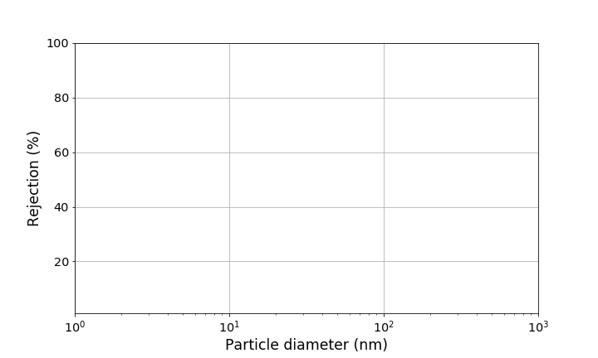
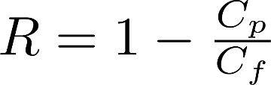
Definition of rejection for Membrane and Ultra Filtration
UF membrane retention rating
MF membrane retention rating

Slide 8
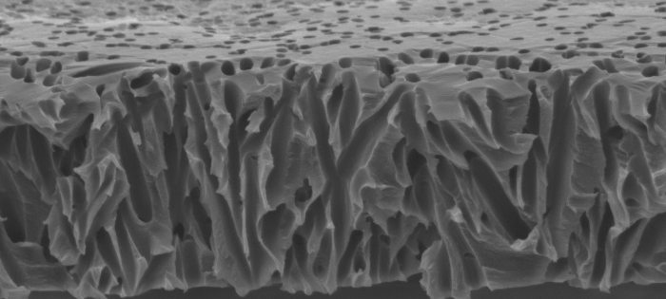
Proposed particle capture mechanisms
Colloidal matter adsorbed to wall of pores
Smaller particles trapped by previously strained particles
Particles strained at the surface
(presumed dominant mechanism)
Notes:
http://www.atl.semtechsolutions.com/node/18/membrane-filtration-technology

Slide 9
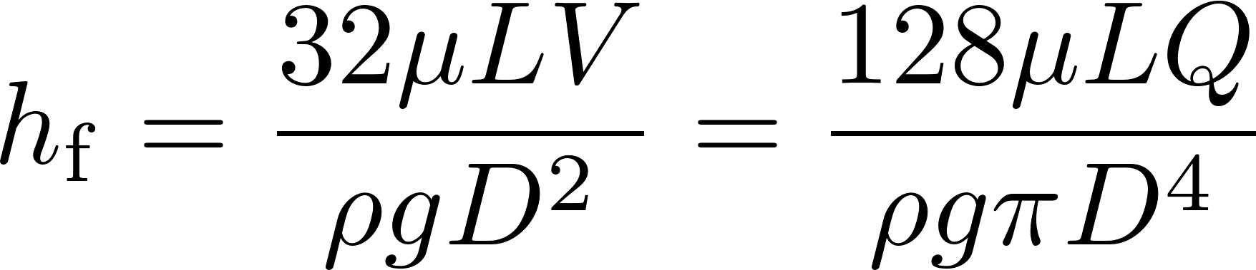
Membrane Hydraulics
Head loss through a clean membrane increases linearly with flow rate
Therefore minor losses must be insignificant!
Pores must be relatively long so that entrance and exit losses are insignificant

Slide 10
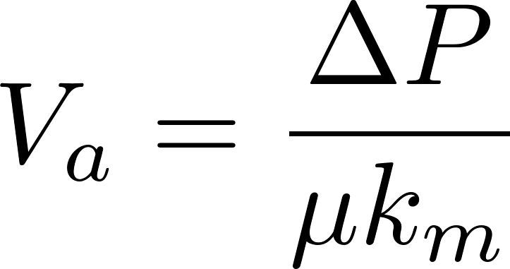
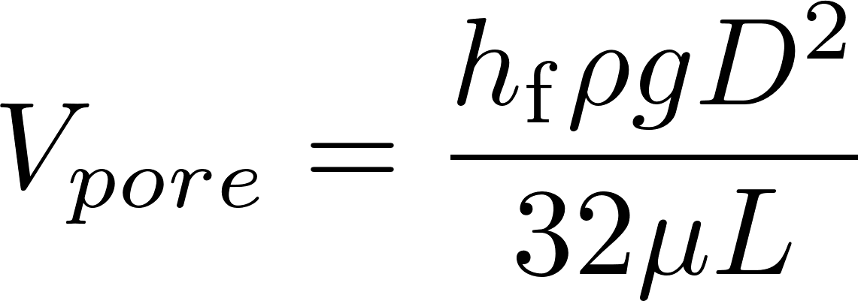
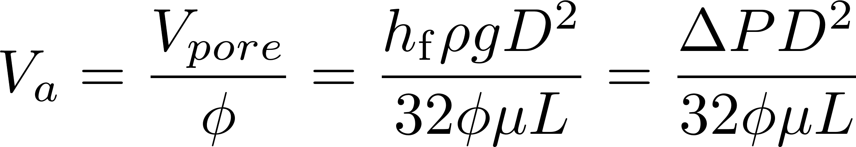
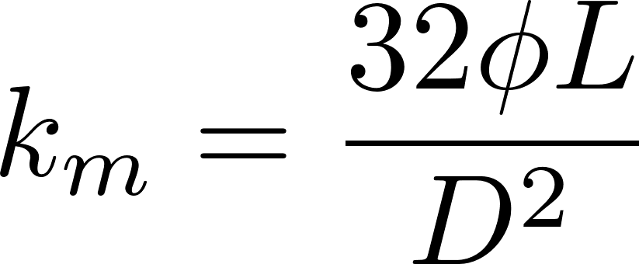
Head loss through membranes
Given that the pore diameter and length are poorly defined, a resistance coefficient is used
From Hagen Poiseuille
Comparing the two equations we see that

Slide 11
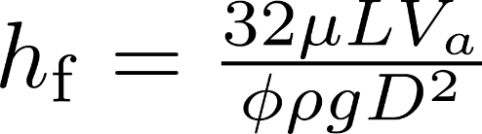
Head loss through membranes
100 nm pore diameter
Porosity of 0.15 (I can’t find any data!)
Pore length of 1000 x diameter (0.1 mm)
Approach velocity of 8 μm/s
Temperature of 15 C
Gives a head loss of 2 m (at the low end of typical clean head loss)

Slide 12
Membranes vs Slow Sand?
Approach velocity for membranes is 8 – 50 μm/s
Approach velocity for SSF is 12 cm/hr = 33 μm/s
Both slow sand and membranes form a filter cake on top of the filter.
Both slow sand and membranes can operate without any coagulant
You can’t backwash SSF and you can’t wrap a SSF into a cartridge!

Slide 13
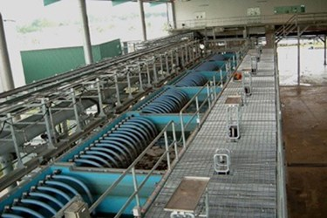
Example product: MEMCOR XS submerged membrane system
Treated capacity from 7.5 – 25 L/s
Compact footprint: 2.4 m x 4.4 m
Net velocity: 0.7 – 2.4 mm/s
This is the area required for the submerged membranes and thus can be compared to the granular filtration area
Requires more space than StaRS filters
Notes:
https://www.evoqua.com/en/brands/Memcor/Pages/memcor-xs.aspx

Slide 14
Floc/floc blanket/sed before membranes?
“If the raw water turbidity and/or NOM concentration is high, pretreatment will include coagulation, flocculation, and sedimentation.”
No indication of what “high” means
Pilot testing recommended
Note that the water industry doesn’t know how to design pilot tests for floc/sed systems that perform as well as full scale
Water and Wastewater Engineering: Design Principles and Practice. Mackenzie Davis

Slide 15
Membrane fouling
Reduction in flow due to accumulation of particles and adsorbed species
Can be reduced with chemical treatment

Slide 16
Membrane cleaning
Backwash velocities are generally much higher than filtration velocities.
Generally a high enough velocity to displace the cake in a single pulse is desirable.
Total volume of backwash must be sufficient to move the particles far enough away from the membrane that they are not re-entrained when forward flow resumes
Chemicals are added to remove molecules that have entered the pores
Notes:
Backwash velocities are generally much higher than filtration velocities. The correct value is more of a black art than a science because it depends on how the particles adhere to each other and to the membrane as well as whether some fraction penetrates into the pores and how tortuous those pores are. It is generally impossible to remove particles that have entered the pore structure, but it is possible to move them sometimes and make them pack into a tighter, less porous, structure. Generally a high enough velocity to displace the cake in a single pulse is desirable. If not enough energy is used, the cake can crack but still remain attached to the membrane. The backwash preferentially flows through the cracks, leaving much of the cake behind. Another consideration is the total volume of backwash. It must be sufficient to move the particles far enough away from the membrane that they settle out and are not re-entrained when forward flow resumes. Mark Hurwitz

Slide 17
Membrane Story: Temple Texas
Expect to treat 15 MGD (2004)
Membranes from Pall Corporation
No pretreatment
$14,800,000
Reduced flow after 1st year 11.6 MGD
2008 upgrade
New chemical clean in place system $590,524
Flocculation/Sedimentation $2,607,785
Total cost – $35,263 per L/s of capacity
2017 capacity reduced to 6 mgd
Notes:
$14,800,000
https://www.kpaengineers.com/portfolio-items/membrane-filtration-plant/
15 MGD
No pretreatment
$22500 /(L/s)
Actuually operates at 11.6 MGD
Project Description: The City of Temple, Texas owns and operates the 11.6 MGD Membrane Water Treatment Plant. The plant was placed into operation in 2004 and operated as originally designed for the first 12 to 15 months. However, over the past several years the plant has not been able to consistently operate at the design capacity. $590,524 to upgrade the chemical cleaning
Realized they needed pretreatment in 2008
Flocculation/Sedimentation $2,607,785
2017 down to 6 mgd
http://www.tdtnews.com/news/article_679b5530-a629-11e7-8d69-0ff68a1a883c.html
See https://moralescompany.com/completed-projects/water-treatment-plants for lots of photos

Slide 18
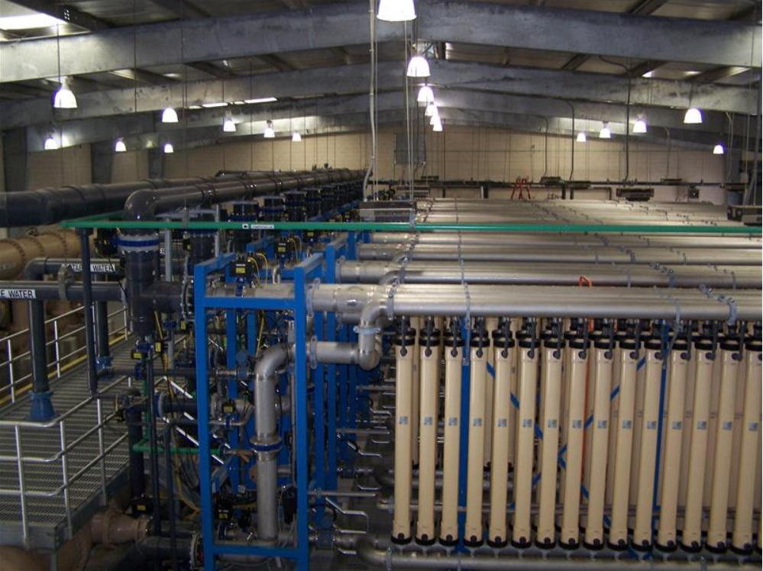
Notes:
See https://moralescompany.com/completed-projects/water-treatment-plants for lots of photos

Slide 19
What’s missing
What solids concentration can membrane filters handle?
How do coagulant nanoparticles interact with membrane filters?
What is the mechanism responsible for head loss build up?
How do membranes handle dissolved organic matter?

Slide 20
How would you compare granular filtration vs membranes?
Concentration of waste stream (and hence fraction of water that must be wasted)
Net velocity (and hence area required)
Useful life (membranes have short lives)
Chemical requirements (membranes require chemical washes) and safe disposal
Capital costs
Membranes produce water with fewer particles!

Slide 21
Case 1: head loss isn’t due to stacking of clay
Does a clay layer form and cause head loss?
Raw water turbidity = 5 NTU
Clay layer is about 130 nm after 1 hour!
Thus there isn’t even one layer of clay in one hour
head loss through an incomplete layer of clay would be insignificant
Thus head loss isn’t due to stacking of clay!
Notes:
d=100 * u.nm
L = 1000*d
V_a = 8 * u.um/u.s
membrane_porosity = 0.15
clay_porosity = 0.4
Temp=15*u.degC
Membrane_HL =( 32*pc.viscosity_dynamic(Temp)*L*V_a/(membrane_porosity*pc.density_water(Temp)*u.standard_gravity*d**2)).to(u.cm)
Clay_density = 2650 * u.kg/u.m**3
Clay_C = 5 * u.NTU
Clay_layer_V = V_a*Clay_C/(Clay_density*(1-clay_porosity))
t = 1*u.hr
Clay_layer_t =( Clay_layer_V * t).to(u.nm)
Clay_layer_t

Slide 22
Case 2: pore blocking analysis
Each clay particle blocks one or more pores
This causes the velocity through the remaining pores to increase and thus the head loss increases
Factor of 5 increase in head loss and hence in velocity during a filter run (guessing)
Thus 1/5 of pores remain open at the end of a run - 80% blocked

